Slide 1
Computer Science and Information Systems Journal: Some Experiences in Managing Papers
Jovana Vidaković Mirjana Ivanović
Miloš Radovanović Vladimir Kurbalija
Department of Mathematics and Informatics
Faculty of Science
University of Novi Sad
Serbia

Slide 2
The ComSIS Journal - introduction
The ComSIS Journal is an international open access, peer reviewed journal published in Serbia from 2004
The Journal is published by the ComSIS Consortium which consists of several academic institutions from Universities from Serbia and Montenegro:
University of Belgrade:
Faculty of Organizational Science
Faculty of Mathematics
School of Electrical Engineering
University of Novi Sad
Faculty of Science
Faculty of Technical Sciences
Faculty of Economics
Technical Faculty
University of Podgorica
Faculty of Economics

Slide 3
The ComSIS Journal - introduction
The ComSIS Journal is an international open access, peer reviewed journal published in Serbia from 2004
The Journal is published by the ComSIS Consortium which consists of several academic institutions from Universities from Serbia and Montenegro:
University of Belgrade:
Faculty of Organizational Science
Faculty of Mathematics
School of Electrical Engineering
University of Novi Sad
Faculty of Science
Faculty of Technical Sciences
Faculty of Economics
Technical Faculty
University of Podgorica
Faculty of Economics

Slide 4
The ComSIS Journal - introduction
The ComSIS Journal is an international open access, peer reviewed journal published in Serbia from 2004
The Journal is published by the ComSIS Consortium which consists of several academic institutions from Universities from Serbia and Montenegro:
University of Belgrade:
Faculty of Organizational Science
Faculty of Mathematics
School of Electrical Engineering
University of Novi Sad
Faculty of Science
Faculty of Technical Sciences
Faculty of Economics
Technical Faculty
University of Podgorica
Faculty of Economics

Slide 5
The ComSIS Journal - introduction
9 volumes (since February 2004), 22 issues
Editors:
Branislav Lazarević (2003-2004)
Vladan Devedžić (2005)
Ivan Luković (2006-2009)
Mirjana Ivanović (2009-present)

Slide 6
The ComSIS Journal
Original papers on both theoretical foundations of computer science and comercial, industrial or educational aspects
Topics:
Computer Science, Information Systems, Software Engineering
Theory, practice
Original research, survey articles
Papers published in English
Papers pass a strict reviewing process

Slide 7
Open-access publishing
The open-access policy of distribution of published articles ensures free availability on the public Internet, permitting any user to read, download, copy, distribute, print, search or link to the full texts of published papers
Points of view:
Readers – ideal
Authors – great, but with concerns about perceived journal quality
Journals – difficulties in generating revenue

Slide 8
Open-access publishing
Good side:
Free access
Searchable and available on the Internet
Problems:
Revenue
Scaling up (finding reviewers, employing stuff, editing, printing)

Slide 9
Indexing
In 2005 professor Vladan Devedžić has started the procedure for including the Journal in Thomson Reuters Reports
Problem at the beginning:
Authors do not wish to submit papers in journals which do not have IF
If the article is not ‘good enough’ it will not be referenced – no or poor IF
Indexing phase can last up to two years

Slide 10
Indexing – Impact factor
In 2008 papers published in the ComSIS Journal are on WoS (Web of Science)
In the 2010 release of Journal Citation Reports by Thomson Reuters, the ComSIS journal received its first two-year impact factor of 0.324
In 2011 – IF 0.625

Slide 11
Indexing – Impact factor
The ComSIS Journal covered or selected for coverage in various indexing services, for example:
Scopus,
EMBASE,
EBSCOhost,
Inspec,
DOAJ,
DBLP and
SCIndex.

Slide 12
Indexing – Impact factor
Since 2008, there was a general increase of interest in the journal
Regular submissions
Proposals of third parties to publish special issues
Increase in the number of published articles starting from 2010

Slide 13
Submission of papers
All papers pass a strict reviewing procedure before being accepted for publication
One or more reviewing cycles
Criteria for final decision:
Originality of the paper
Matching the scope of the journal
Academic merit
Quality of presentation
Technical correctness, etc.

Slide 14
Submission of papers
Initial examination of the submitted article
Immediately rejection by Editor-In-Chief and three members of Editorial Board:
Out of scope
Does not meet the basic criteria for a journal article
Very often since the impact factor has been announced

Slide 15
Statistics
Since the IF has been announced the number of submited papers has increased

Slide 16
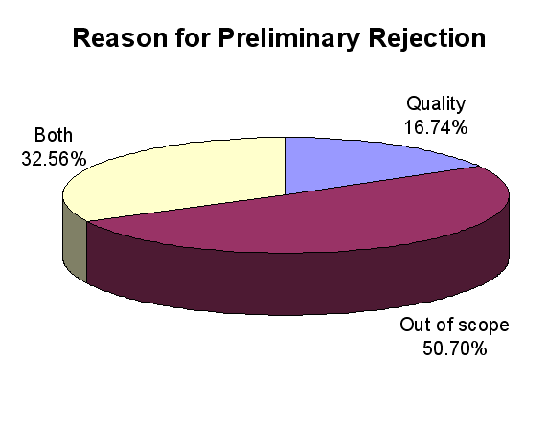
Statistics – Reasons for preliminary rejection
Distribution of preliminarily rejected papers by reason
from January 2010 to August 2012.

Slide 17
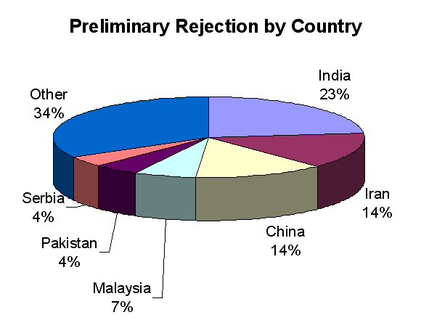
Statistics – Preliminary rejection by country
Distribution of preliminarily rejected papers by country
from January 2010 to August 2012.

Slide 18
Plagiarism
A significant number of plagiarised and self-plagiarized submissions
Minimal changes done to already published paper
Several submissions of the same paper to different journals
Detection during the review stage

Slide 19
Article citation
Number of citation rises from 2009 when ComSIS was included in the SCI-Expanded journal list by Thomson Reuters
A large increase in the number of citations to ComSIS articles in 2011

Slide 20
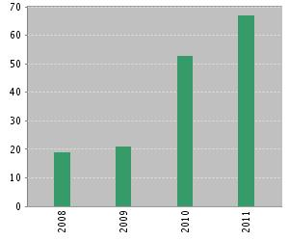
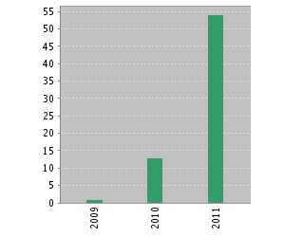
Article citation
a) Published Items in Each Year | b) Citations in Each Year
Number of ComSIS articles published each year (a) and number of citations in each year (b), according to Web of Science (May 8, 2012).

Slide 21
Article citation
The increase of the number of citations in 2011 can be explained partly by the increased volume of published articles
Efforts of the editorial staff to make the journal more visible (covered in more indexing databases) – started in 2009

Slide 22
Discussion
The number of papers is increasing, especially when the IF was announced
The number of ‘good’ papers is constant
Try to keep the quality of published papers constant
The result is new and better IF – 0.625

Slide 23
Thank you!
Thank you for your attention!
Visit The ComSIS Journal
www.comsis.org

